Slide 1
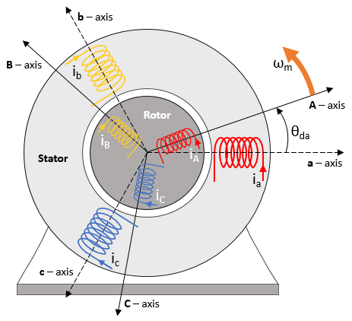
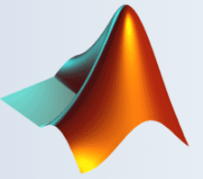

Fault Detection Of Induction Motor Using Machine Learning And Signal Processing
BEE-14A
Group members:
Awais Asghar
Muhammad Ashar Javid
Muhammad Hammad Sarwar

Slide 2
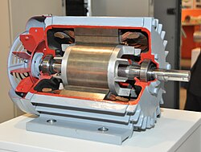
INTRODUCTION
Induction motors play a crucial role in powering industrial machinery.
Reliable motor operation is vital for productivity and safety.
Motor faults can lead to downtime, increased maintenance costs, and compromised efficiency.
Our objective is to develop a system for early fault detection in induction motors.
Utilize machine learning and signal processing for accurate and automated fault detection.

Slide 3


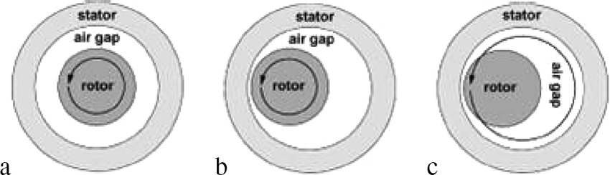

Defects
1. Eccentricity
Imbalance in the rotor's position relative to the stator.
Detectable through changes in current harmonics.

Slide 4
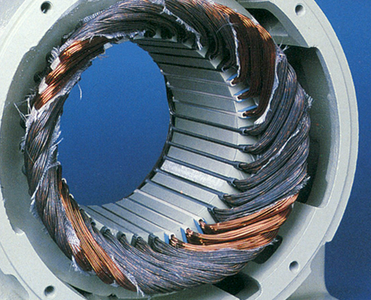
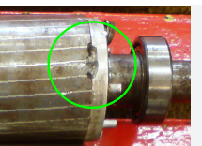
2. Stator Winding Faults:
Includes short circuits or insulation degradation.
Early fault detection is possible by monitoring unbalanced currents or variations in voltage.
3. Broken Rotor Bars:
Leads to asymmetry in the rotor, causing current distortions and torque pulsations.
Easily detectable in the stator current spectrum.

Slide 5
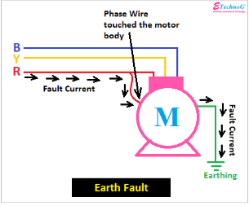
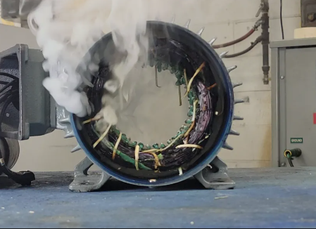
4. Earth Faults:
Leakage of current to the ground, leading to safety risks and inefficiencies.
Visible in current monitoring.
5. Overload:
Excessive current due to overloading, reducing motor life and efficiency.
Detectable through voltage drops and high current readings.
6.Unbalanced Supply Voltage or Current:
Leads to overheating and vibration, affecting motor performance.
Easily monitored using electrical signal analysis.

Slide 6
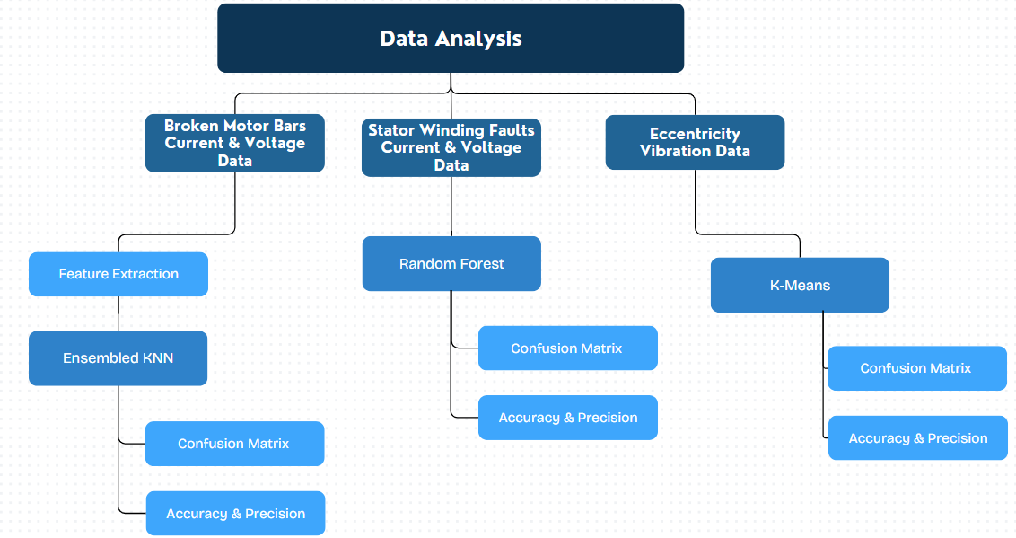
Working Methodology (I)

Slide 7
Working Methodology (II)
Unbalanced Voltage Supply
Input Comparison within range of 5%
Ground fault
Sum of all line currents
Overload
Comparison with rated current

Slide 8
Simulink Model Design & Workflow
Constructed a three phase induction motor on Simulink.
Generated following faults in the motor:
Stator Open Circuit: Break in the electrical circuit.
Stator Short Circuit: Inter-turn current bypassing.
Motor Overload: Excessive current is drawn, surpassing limits.
Broken Rotor Bar: Physical damage to rotor bars affecting motor performance.

Slide 9
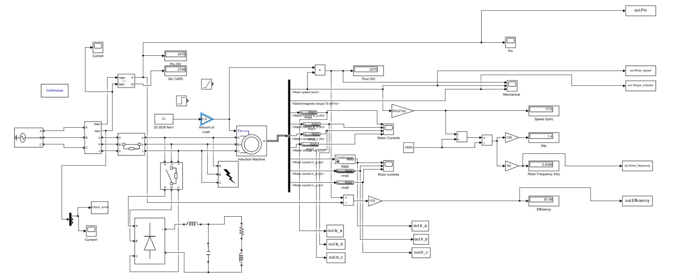
Simulink Model

Slide 10
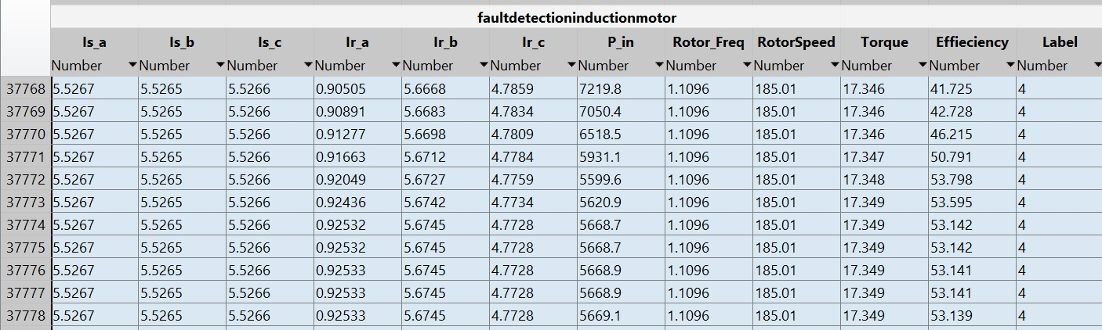
Simulink Model Design & Workflow
Collected data of 150,000 data points with 60-40% ratio of healthy to faulty motor data.
Following parameters were considered for data collection
Stator Currents
Rotor Currents
Input Power
Slip
Rotor Speed
Efficiency

Slide 11
Simulink Model Design & Workflow
Divided the data into training and test set with 70-30% ratio.
Trained different machine learning models on the generated dataset.
Compared the accuracy of the models on test set.
Chose the model with best results.

Slide 12
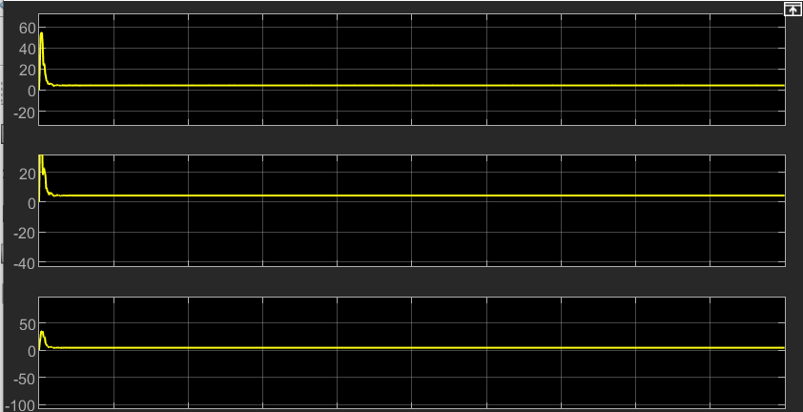
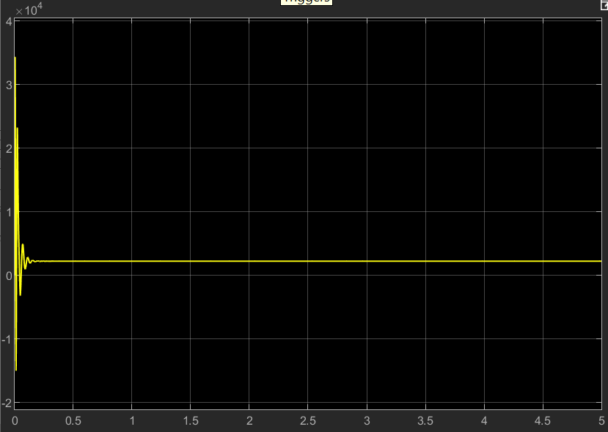
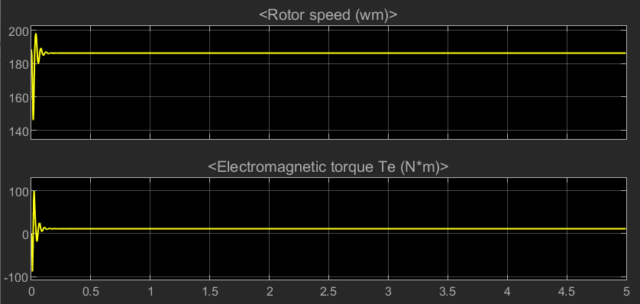
Normal Motor
Stator Currents
Input Power

Slide 13
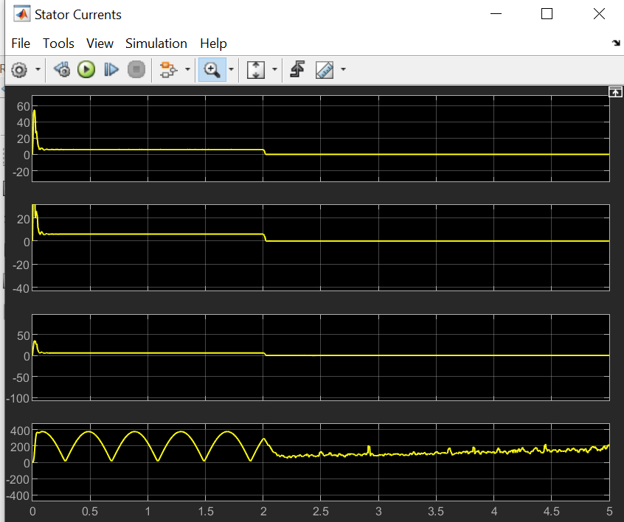
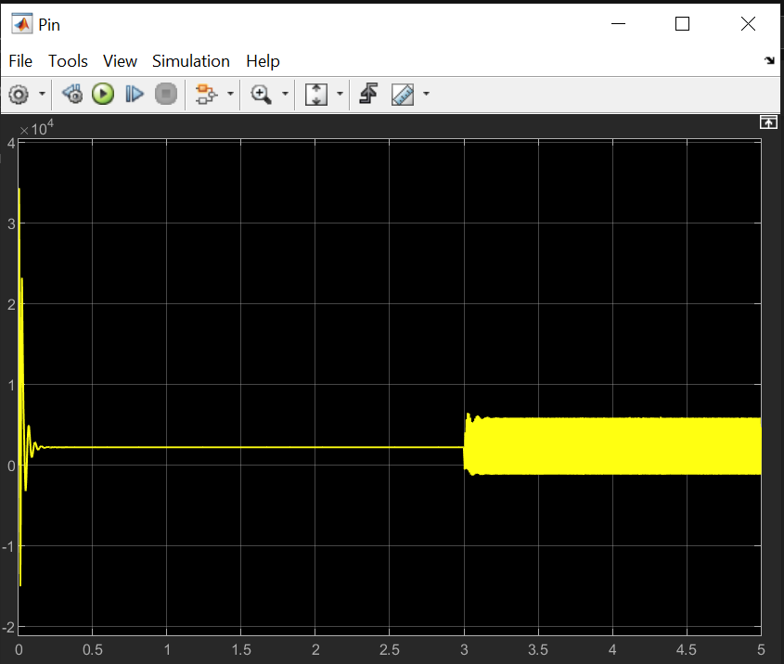
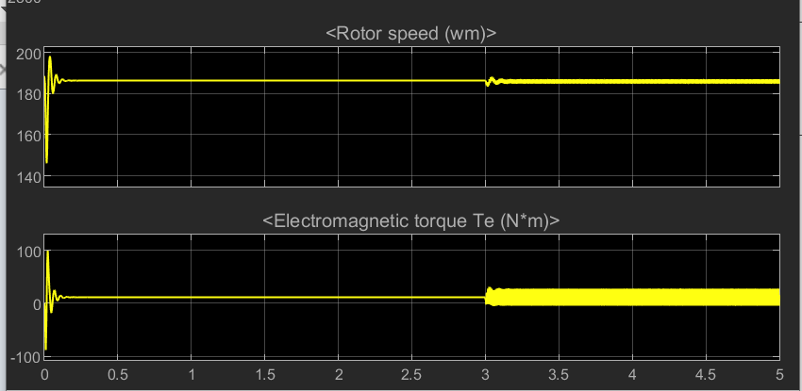
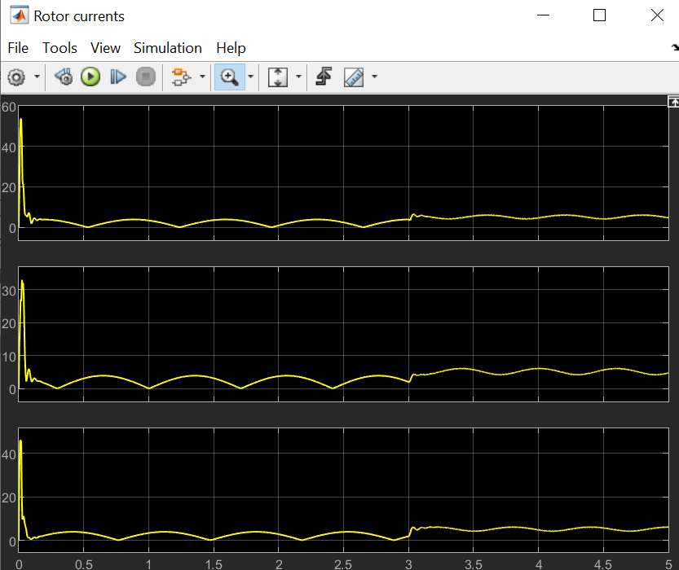
Open Circuited
Stator Currents
Input Power
Rotor Currents

Slide 14
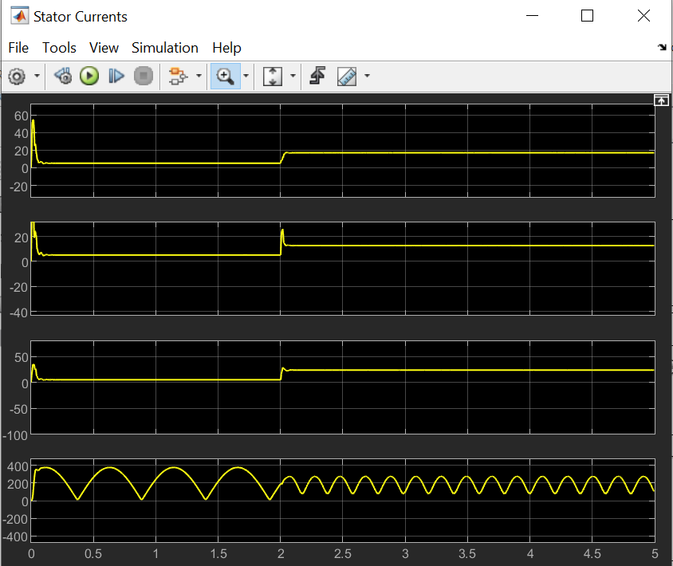
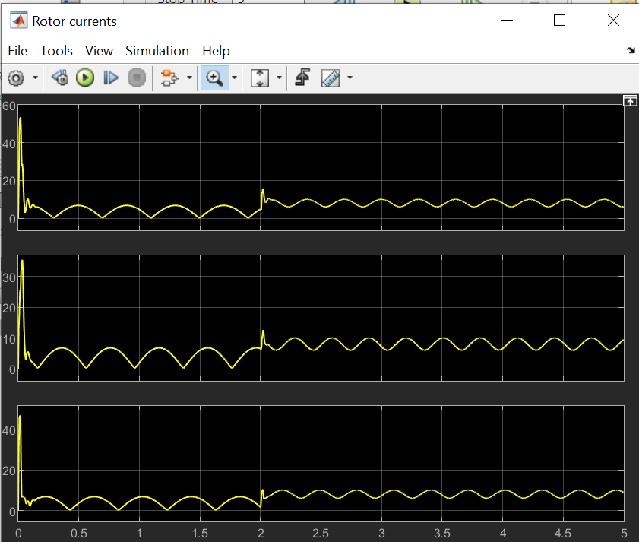
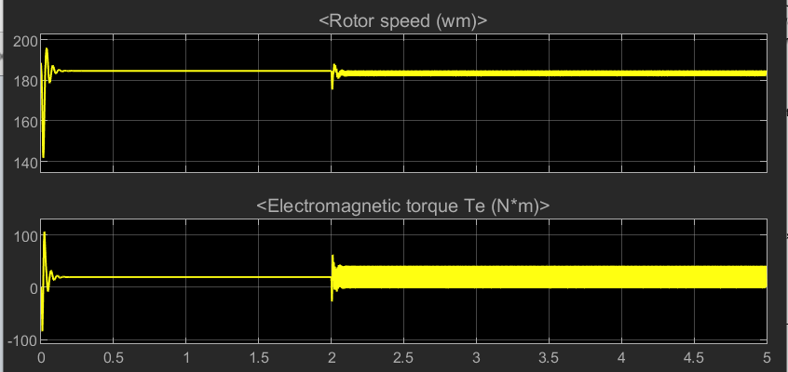
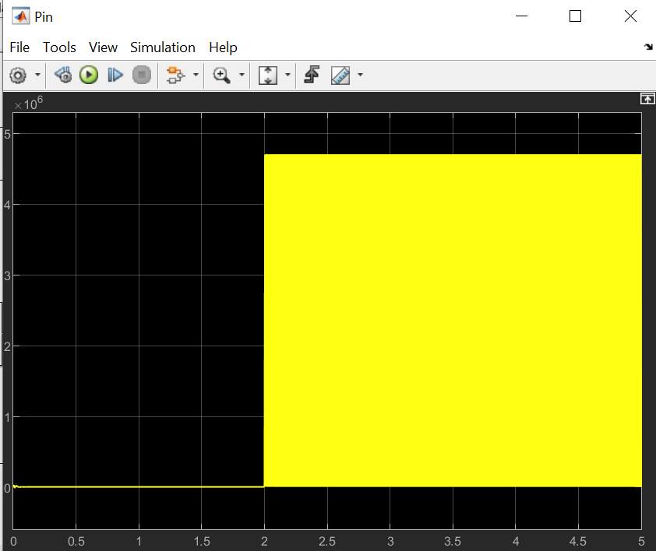
Short circuit
Stator Currents
Rotor Currents
Input Power

Slide 15
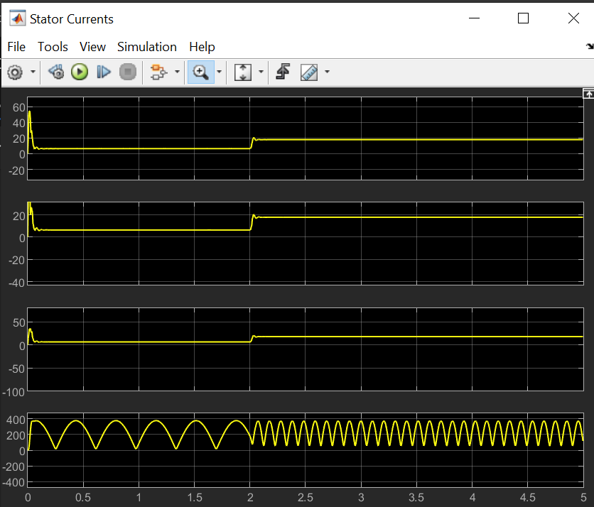
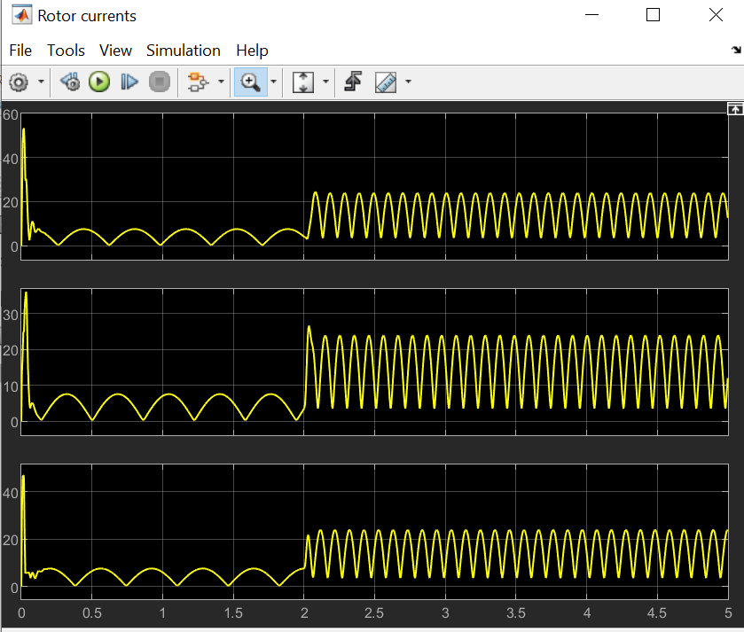
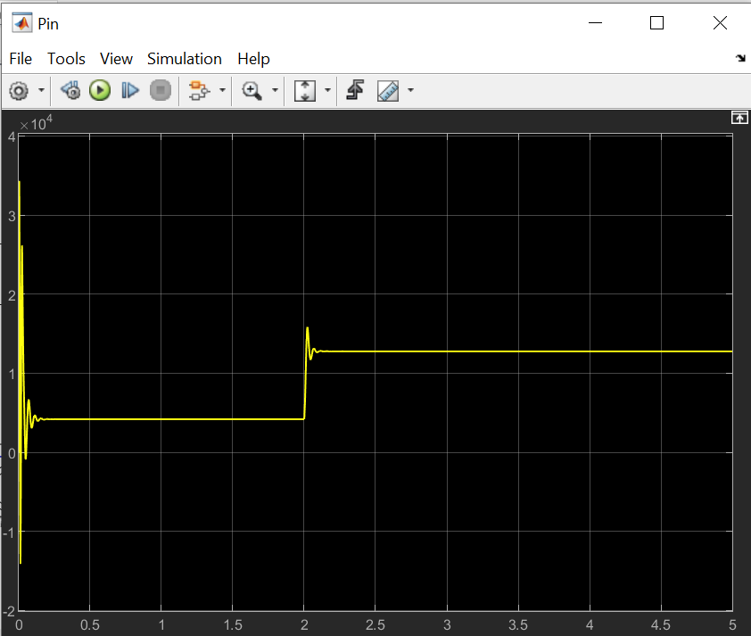
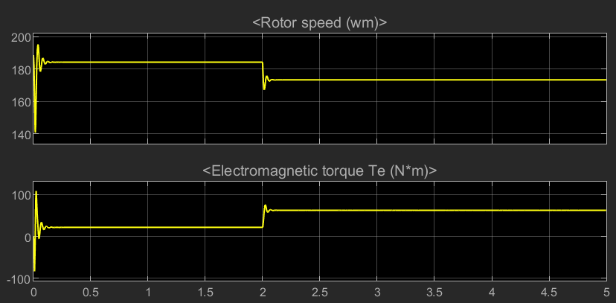
Overload
Stator Currents
Rotor Currents
Input Power

Slide 16
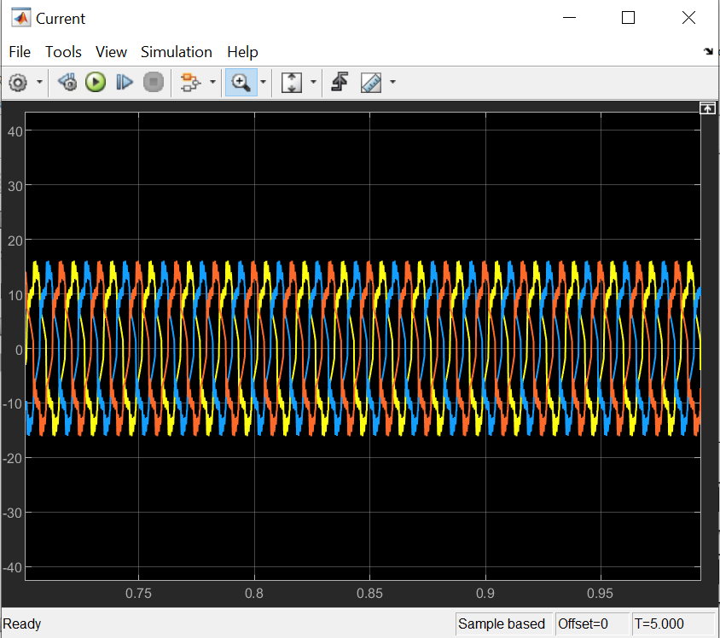
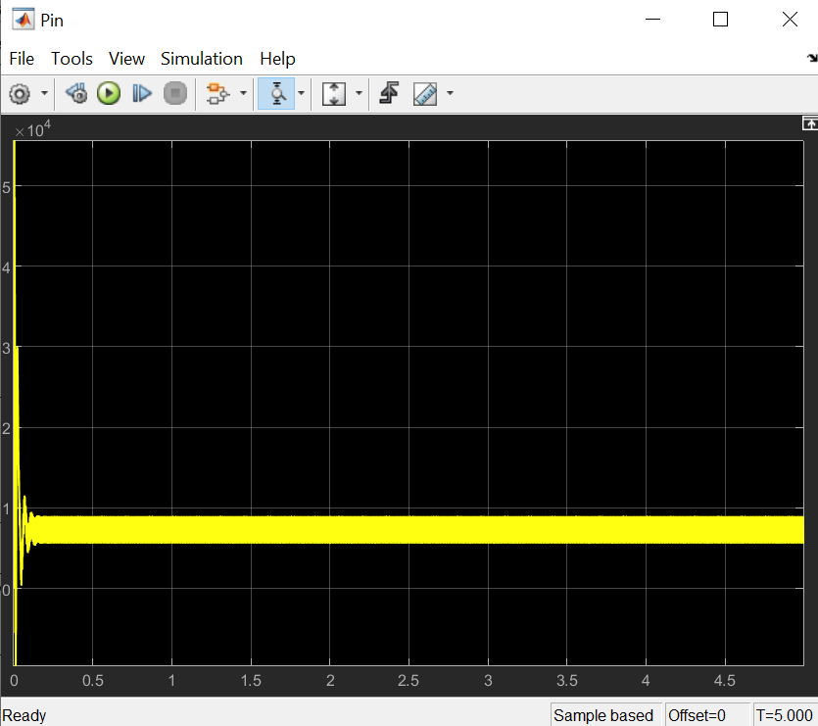
Rotor bar broken
Stator Currents
Input Power

Slide 17
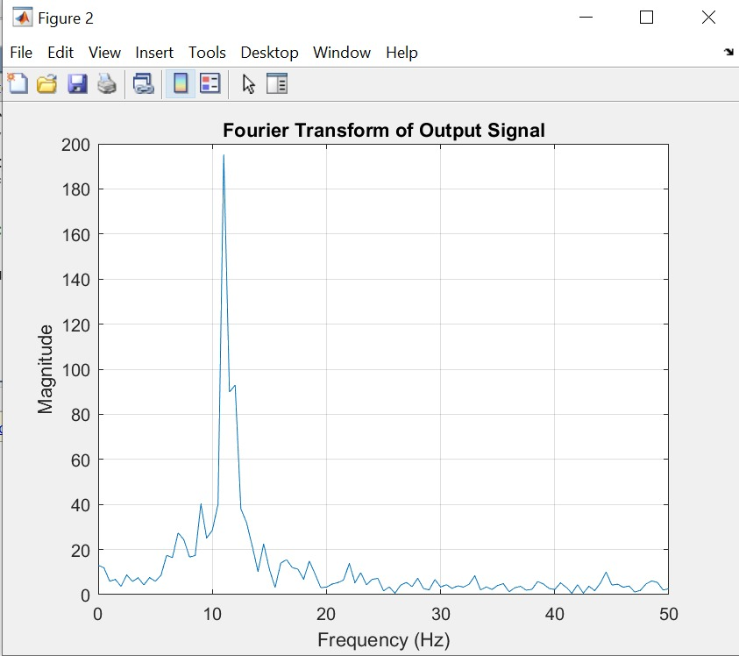
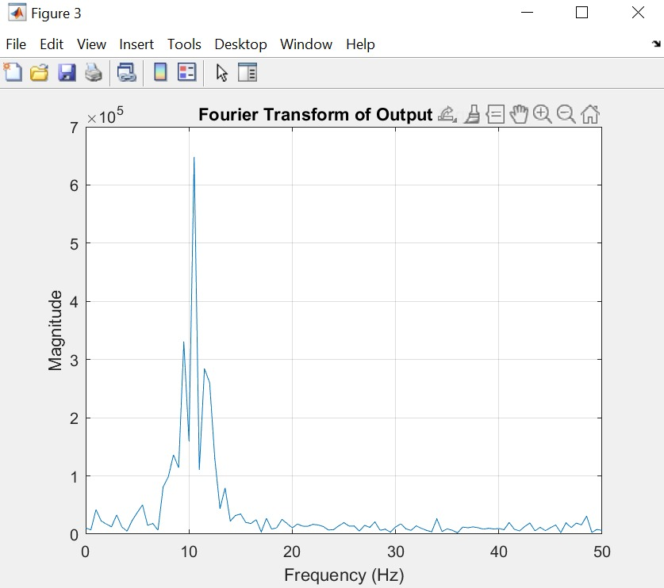
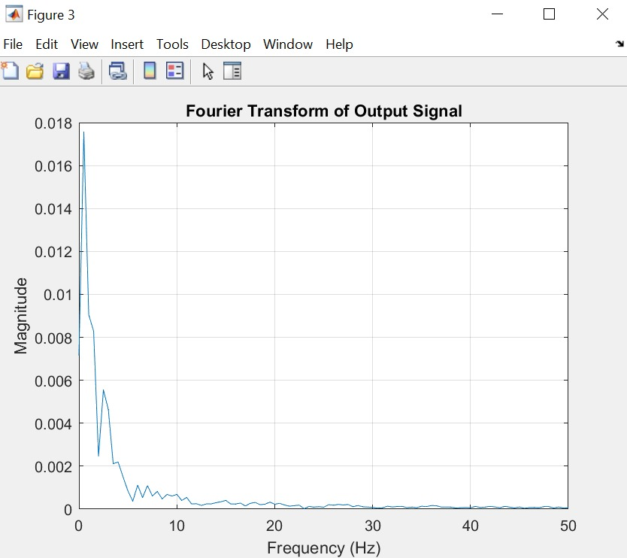
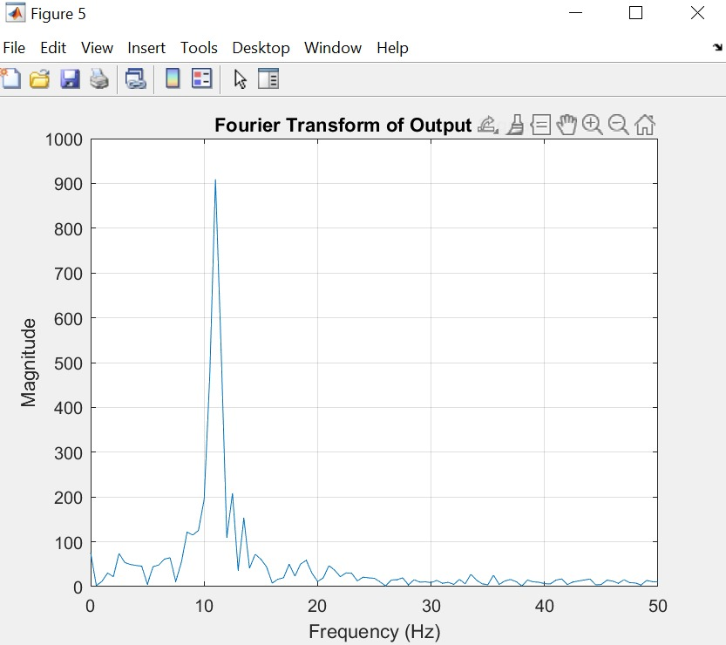
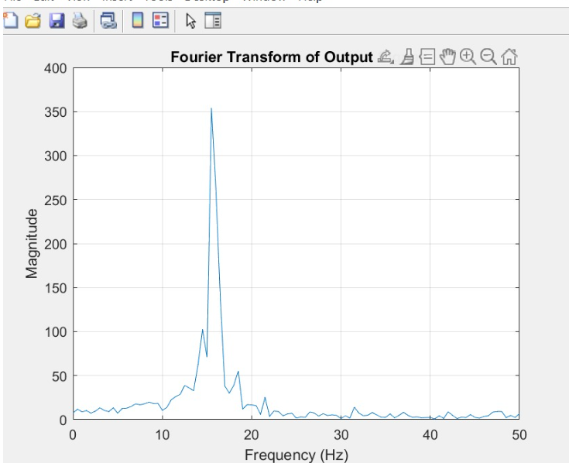
Short-
Circuit
Healthy
Open-
Circuit
Overload
Broken Rotor Bar

Slide 18
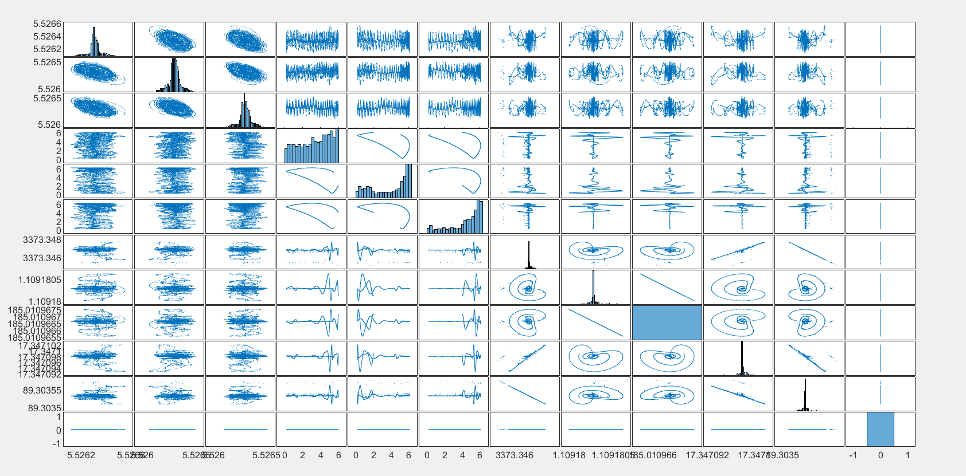
Plot Matrix

Slide 19
Performance of Machine Learning Models
Model | Accuracy | Recall | F1 Score
Decision Trees | 92.1 | 0.95 | 1.13
Logistic Regression | 61.3 | 0.43 | 0.87
Naïve Bayes | 42.8 | 0.78 | 1.07
K-Nearest Neighbors (KNN) | 52 | 0.63 | 0.8
Support Vector Machines (SVM) | 63 | 0.74 | 0.6

Slide 20
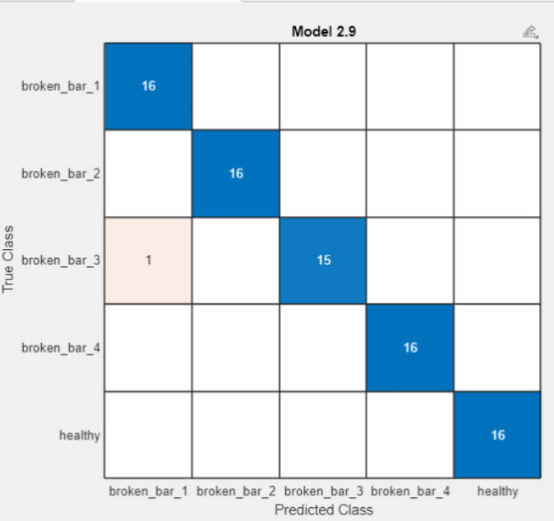
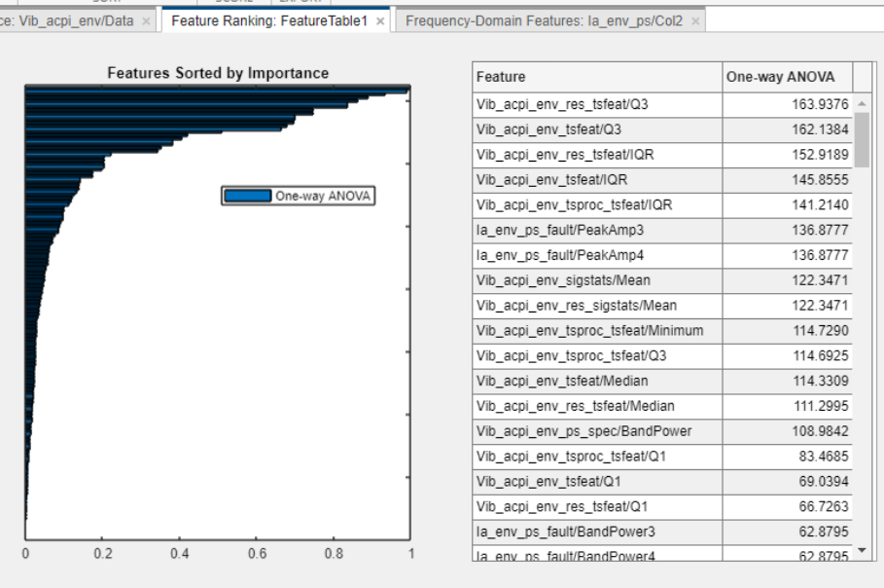
Accuracy & Precision
Dataset: https://ieee-dataport.org/open-access/experimental-database-detecting-and-diagnosing-rotor-broken-bar-three-phase-induction

Slide 21

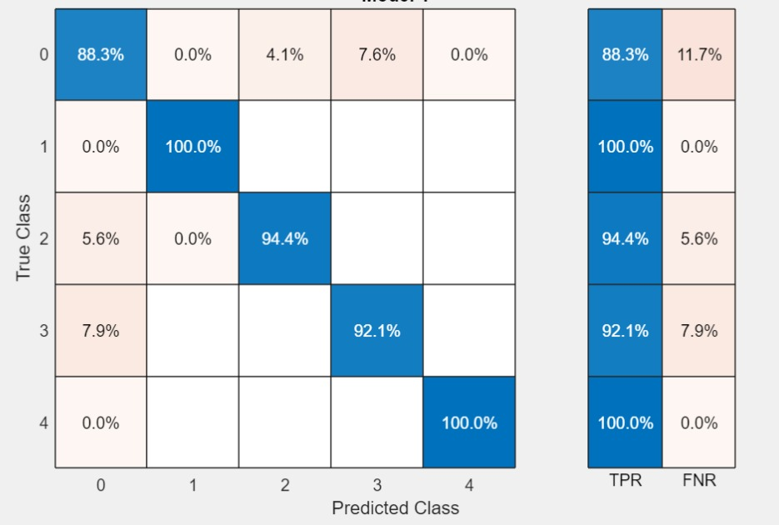
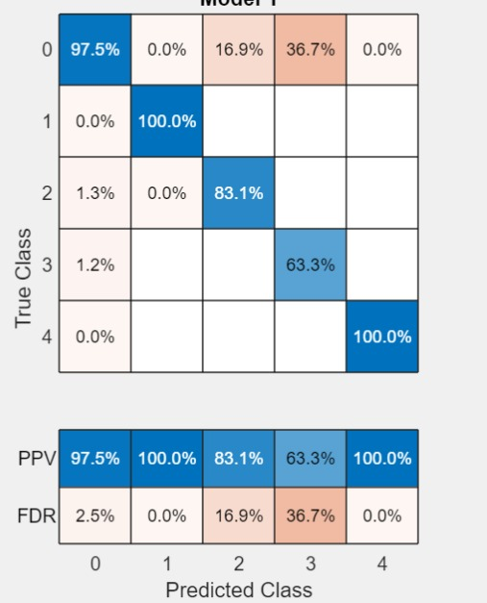
Decision Trees
Confusion Matrix

Slide 22
Conclusion
Successfully identified six major faults in induction motors
Utilized MATLAB for signal processing to analyze fault signatures using time-frequency and spectral analysis.
Implemented machine learning models to classify and predict faults with high accuracy.
Achieved reliable and early fault detection, reducing maintenance costs and downtime in industrial systems.
Demonstrated the effectiveness of integrating signal processing and machine learning for advanced condition monitoring.

Slide 23
Research Areas
Thermography and Deep Learning: Utilizing thermal imaging with models like InceptionV3 for non-invasive fault detection.
Hybrid Diagnostic Approaches: Combining traditional modeling with machine learning to improve fault detection reliability.
Explainable AI Models: Implementing transparent machine learning models for better understanding of stator fault diagnostics.
IoT-Based Predictive Maintenance: Developing predictive maintenance models using real-time IoT data for proactive fault management.

Slide 24
References
https://www.mathworks.com/matlabcentral/fileexchange/67214-dyanamic-modeling-of-induction-motor-in-simulink?s_tid=FX_rc2_behav
https://www.ijettjournal.org/2015/volume-24/number-5/IJETT-V24P245.pdf
deep learning approach for electric motor fault diagnosis based on modifed InceptionV3 Lifu Xu, Soo SiangTeoh* & Haidi Ibrahim
Fault Detection of Induction Motors with Combined Modelingand Machine-Learning-Based Framework Moritz Benninger 1,* , Marcus Liebschner 1 and Christian Kreischer 2
Predictive Maintenance Model Based on Anomaly Detection in Induction Motors: A Machine Learning Approach Using Real-Time IoT Data Sergio F. Chevtchenko 1 , Monalisa. C. M. dos Santos 1 , Diego. M. Vieira 1 , Ricardo. L. Mota 1 , Elisson Rocha 1 , Bruna. V. Cruz 1 , Danilo Araujo ´ 2 , Ermeson Andrade2

